Slide 1

የደቡብ ኢትዮጵያ ክልላዊ መንግስት ደቡብ ኢትዮጵያ ነጋሪት ጋዜጣ
DEBUB ETHIOPIA NEGARIT GAZETA OF THE SOUTH ETHIOPIA REGIONAL STATE
ደንብ ቁጥር 101/፳፻፲፰ ዓ.ም
የደቡብ ኢትዮጵያ ክልላዊ መንግስት የገጠር መጠጥ ውሀና ሳኒቴሽን ማህበር፣የማህበራት ፌዴሬሽንና የብዝሀ ቀበሌ ማቋቋሚያ ደንብ---ገፅ
Regulation No. 101/2026
Rural Potable Water and Sanitation Associations, Federation and
Multi-Kebele Establishment Regulation
https://proceed-eth.org/doku.php?id=ws:ws2-s00

Slide 2
Regulation Outline
ክፍል አንድ: ጠቅላላ
ክፍል ሁለት: ስለገጠር መጠጥ ውሀና ሳኒቴሽን ማህበራት አመሠራረትና ምዝገባ
ክፍል ሶስት: የገጠር መጠጥ ውሃና ሳኒቴሽን አገልግሎት ሰጪ ድርጅት አደረጃጀት
ክፍል አራት: የገጠር መጠጥ ውሀና ሣኒቴሽን ማህበራት ፌዴሬሽን ሃላፊነት እና አደረጃጀት
ክፍል አምስት: ብዝሀ ቀበሌ የገጠር መጠጥ ውሃና ሳኒቴሽን አገልግሎት ሰጪ ድርጅት አደረጃጀትና አሰራር
ክፍል ስድስት: የገጠር የመጠጥ ውሃ እና ሳኒቴሽን አገልግሎት ድርጅት ምዝገባ እና መተዳደሪያ ደንብ
ክፍል ሰባት: ስለ የገንዘብ ምንጭ፣ የገቢ አጠቃቀም፣ ኦዲትና ኢንስፔክሽን
ክፍል ስምንት: ልዩ ልዩ ድንጋጌዎች
Part one : General
Part Two : Establishment and Registration of Rural Potable Water and Sanitation Association
Part Three : Rural potable water sanitation service provider organisation
Part Four :Rural water sanitation User Association Federation, Role and structure
Part Five : Establishment and Role of Multi-Kebeles Rural Potable Water and Sanitation Organization
Part Six : Registration and bylaws of Rural Potable Water Service Organisation
Part Seven : Finance sources; revenue utilization, audit and inspection
Part Eight : Miscellaneous Provisions

Slide 3
Regulation Objectives
Adopt a unified approach to all rural water service organizations in South Ethiopia, ranging from on-spot water points to multi-kebele systems.
Draw on the experience of the South Region Bureau of Water in piloting an effective federation network in Wolayita and Gamo to define a practical organizational structure.
Translate the directions of the federal "Rural Water Supply Operation and Maintenance Strategic Framework" into an adapted organizational system.
Recognize that associations are a foundational element of rural maintenance in Ethiopia that must be reinforced by higher-level organizations.

Slide 4
Organization of Service Providing Organizations
፮. የገጠር መጠጥ ውሀና ሳኒቴሽን አገልግሎት ድርጅቶች የሚከተሉት አደረጃጀቶች ይኖራቸዋል ፩. የገጠር መጠጥ ውሀና ሳኒቴሽን ማህበራት ፪. የቀበሌ ገጠር መጠጥ ውሀና ሳኒቴሽን ማህበራት ፌዴሬሽን ፫. ብዝሀ ቀበሌ የገጠር መጠጥ ውሀና ሳኒቴሽን ድርጅት |  | Organization of Service Providing Organizations Service providing organizations shall have the following structure. Association Federation and Multi-kebele
“የገጠር መጠጥ ውሃና ሳኒቴሽን ማህበር” ወይም “ማህበር” በገጠር ቀበሌያት የመጠጥ ውሃና ሳኒቴሽን ተጠቃሚዎች በጋራ በመሆን የሚመሰርቱት የገጠር መጠጥ ውሃና ሳኒቴሽን ማህበር ነው፡፡ |  | “Rural water supply and sanitation Association” or “Association” established by potable water and sanitation service users in a rural kebele.
“የማህበራት ፌዴሬሽን" ወይም “ፌዴሬሽን” ማለት በአንድ የገጠር ቀበሌ ሁለትና ከዚያ በላይ የገጠር መጠጥ ውሀና ሳኒቴሽን ማህበራትን ያቀፈ አደረጃጀት ያለውና የገጠር መጠጥ ውሃና ሳኒቴሽን አገልግሎት ሰጪ ድርጅት ነው፡፡ |  | “Associations’ Federation” or “Federation” means a service provider organization that constitutes two or more water and sanitation associations in a single rural kebele.
“ብዝሀ ቀበሌ የገጠር መጠጥ ውሃና ሳኒቴሽን ድርጅት” ማለት “ብዝሀ ቀበሌ” ለሁለት እና ከዚያ በላይ ለሆኑ የገጠር ቀበሌዎች፣ ወረዳዎች ወይም ዞኖች የውሀ መገኛው ከጥልቅ ጉድጓድ፣ ከምንጭ ወይም ከወንዝ የተጠለፈ ሆኖ በአንድ አስተዳደራዊ ወሰን ሳይገደብ አገልግሎት የሚሰጥ የገጠር የንፁህ መጠጥ ውሀና ሳኒቴሽን ድርጅት ማለት ነው፡፡ |  | “Multi-kebele rural potable water and sanitation organization” or “Multi-Kebele” is a rural potable water and sanitation organization providing services to users of more than one kebele, woreda, or zone through water scheme regardless of administrative boundaries.
Association
Association
Association
Association
Association
are part and form a
Federation or Multi-Kebele

Slide 5
Establishment and Registration of Rural Potable Water and Sanitation Association
፰. የገጠር መጠጥ ውሀና ሳኒቴሽን ማህበር አመሰራረት፡ |  | Establishment of Association
፩.የገጠር መጠጥ ውሀና ሳኒቴሽን ማህበር በአንድ ገጠር ቀበሌ ውስጥ የመጠጥ ውሀ አገልግሎት በሚሰጥባቸው ውሀ መገኛ ልክ ማህበር ይመሰረታሉ፡፡ |  | Associations shall be established in a rural kebele based on number of water schemes where potable water services are provided.
፪. የገጠር መጠጥ ውሀ ተቋሙን የሚጠቀሙ ቋሚ ተጠቃሚዎች በሙሉ የማህበር አባል የመሆን ግዴታ አለባቸው፡፡ |  | All permanent users of the water scheme are obliged to be members of the association.
፫. በቀበሌ ውስጥ ያሉ ሁሉም የገጠር መጠጥ ውሀና ሳኒቴሽን ተቋማት በማህበር ይታቀፋሉ፡፡ |  | All water schemes in a kebele shall be incorporated in an association.
Association Executive Committee
Report
Elect
Optional :
WP Committee
Elect
General Assembly :
All Scheme Water Users

Slide 6
Establishment and Registration of Rural Potable Water and Sanitation Association
Extend of an Association:
One association per scheme ( one or more Water Point on the same network) within a Kebele
Examples:
① Association for Multi-WP Scheme
② Association for Single-WP Scheme (on spot – Hand Pump)
③ Association for part of a Multi-WP Scheme where scheme cross Kebele border
Asso
①
②
Asso
Kebele 2
Asso
③
Asso
Kebele 1

Slide 7
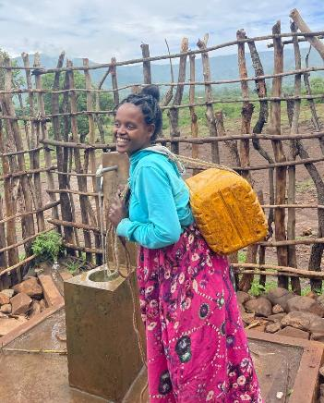
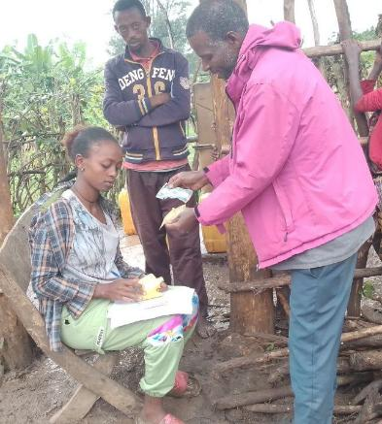
Right and Duties of Members of Association
፱ ስለማህበር አባላት መብትና ግዴታ ፩. ሁሉም የውሃ ተጠቃሚዎች የማህበር አባላት ሲሆኑ ፣ ውሃ የማግኘት መሰረታዊ መብት አላቸው |  | Right and Duties of Members of Association All water users are members an association and they have basic right to access water..
፪. የማንኛውም ማህበር አባል የሚከተሉት መብቶች ይኖሩታል፡፡ ሀ) ማህበሩ የሚሰጠውን አገልግሎት የማግኘት፣ ለ) በማህበሩ ጉባኤዎች የመካፈልና ድምፅ መስጠት |  | 2. Any member shall have the following rights. Accessing the services provided by the association; Participating and voting in the meetings of the association;
፫. ማንኛዉም የማህበር አባል የሚከተሉት ግዴታዎች ይኖሩበታል ሀ) መተዳደሪያ ደንቡን፣የማህበሩ ዉሳኔዎችና መመረያዎችን የማክበር፣… መ) የመመዝገቢያና የውሃ አገልግሎት መዋጮ ክፊያዎችን የመክፈል፣ |  | 3. Any member of the association shall have the following duties. Respect the bylaw, decisions and directives of the association; … b) Pay registration and water service fees;
Association membership is a right that comes with obligations.

Slide 8
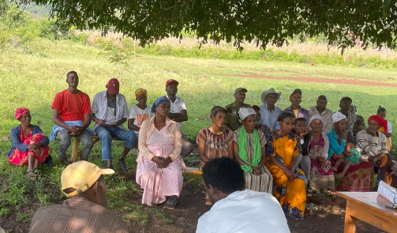
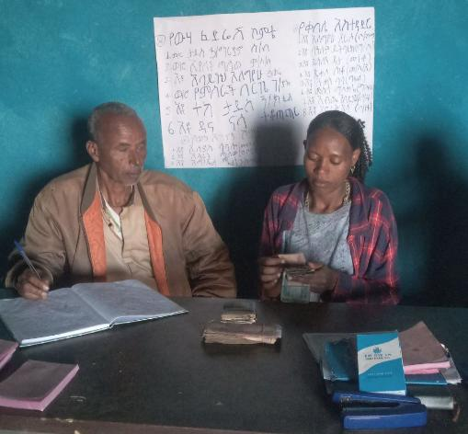
Right and Duties of Members of Association
፲. የገጠር መጠጥ ውሀ ሳኒቴሽን ማህበራት ኃላፊነትና ተግባር፡- ፪. ሁሉንም ቋሚ የውሃ ተጠቃሚዎች በአባልነት መያዝ፣ ፫. ከውሀ አገልግሎት ታሪፍ የሚገኘውን ገቢ በመሰብሰብ የተሰበሰበውን ገንዘብ መልሶ ለመጠጥ ውሀ አገልግሎት ማስፋፊያ እና ጥገና ወጪ እንዲውል በሕጋዊ ደረሰኝ ለአገልግሎት ሰጪ ድርጅቶች ገቢ የማድረግ፣ |  | Powers and Duties of Association 2.Take all permanent water users as members 3.Collect fees from water service and remit the money to service provider organizations via legal receipts
፲፫. ስለ ማህበራት ጠቅላላ ጉባዔ ሥልጣንና ተግባር ፩ ጠቅላላ ጉባዔ የማህበሩን አባላት በሙሉ ያቀፈ ሆኖ የማህበሩ የበላይ የሥልጣን አካል ነው፡፡ … ፫ የማህበሩን የስራ አስፈጻሚ ኮሚቴዎችን ይመርጣል፤ይሽራል። |  | Powers and Functions of the General Assembly of Association 1.The General Assembly shall encompass all members of the association and is the higher organ of the association. … 3.Elects and dismisses members of the executive committee of the association.
Association are led by the Water Users gathered in a General Assembly

Slide 9
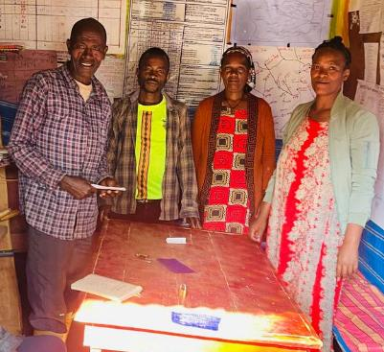

Right and Duties of Members of Association
፲፬. የማህበራት ሥራ አስፈፃሚ ኮሚቴ አመራረጥ ፩ በጠቅላላ ጉባዔው አብላጫ ድምፅ ይመረጣሉ፡፡ ፪ የሥራ አስፈፃሚ ኮሚቴው ቁጥር /ብዛት/ ከአምስት እስከ ዘጠኝ ሆኖ የሴቶች ተሳትፎ ትኩረት ይሰጥበታል፡፡ ዝርዝሩ በመመሪያ ይወሰናል፡፡ ፫ የስራ አስፈፃሚ ኮሚቴው የስራ ዘመን ከ3 ዓመት መብለጥ የለበትም ሆኖም የስራ ዘመኑን የጨረሰ የስራ አስፈፃሚው ኮሚቴን ለመተካት በሚደረግ ምርጫ ላይ የነባሩ ኮሚቴ አባል የሆነ በጠቅላላ ጉባኤው አባላት ጥንካሬው ከተረጋገጠ በድጋሚ ለሁለተኛ ጊዜ ሊመረጥ ይችላል፡፡ይህም የመጨረሻ ይሆናል፡፡ |  | Selection of Executive Committee of Association Members of the executive committee shall be elected by majority vote of the General Assembly The number of the executive committee members shall be between five and nine and ensures women’s participation. The term of service of member of the executive committee shall not exceed 3 years; however, a member may be re-elected, if his performance is confirmed by the General Assembly, for a final time.
፲፮. ስለ ማህበር መፍረስ ሀ) በማህበሩ ውስጥ ምንም አባል ወይም የውሃ ተጠቃሚ ከሌለ፣ ለ) የውሃ ተቋሙ መልሶ አገልግሎት መስጠት የማይችል መሆኑ ሲረጋገጥ፣ ሐ) የገጠር መጠጥ ውሀ ተቋማት ወደ ከተማ ውሀ አገልግሎት ደረጃ ሲያድጉ ወይም ሲካተቱ፣ |  | Dissolution of Association a) Where the association has no member or if there is no water user; b) Where it is proved that the water scheme can no longer be in service even after maintenance; c) Where the rural potable water schemes are upgraded to a level of an urban water service
Objective to have at least 50% of Women in Association Committees.
Association cannot be dissolve if the scheme continue to serve rural users

Slide 10
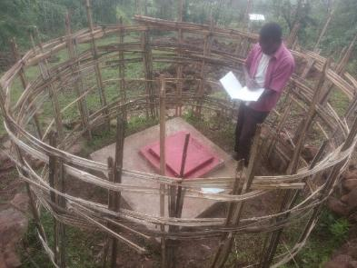
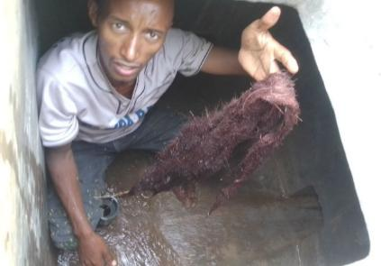
Establishment and Structure of Service Provider Organization
፲፯. የቀበሌ ገጠር መጠጥ ውሀና ሳኒቴሽን አገልግሎት ሰጪ ድርጅት አመሰራረት፡- ፩. ሁሉም የገጠር መጠጥ ውሀና ሳኒቴሽን ማህበራት የአገልግሎት ሰጪ ድርጅቱ አባል የመሆን ግዴታ ይኖርባቸዋል፡፡ ፪. በአንድ ቀበሌ ውስጥ ከአንድ በላይ የቀበሌ ገጠር መጠጥ ውሀና ሳኒቴሽን አገልግሎት ሰጪ ድርጅት ሊኖር አይችልም፡፡ |  | Establishment of Service Provider Organization All associations shall be obliged to be members of the service provider organization. There shall not be more than one service provider organization in a kebele.
፲፰. የገጠር መጠጥ ዉሀ ሳኒቴሽን አገልግሎት ሰጪ ድርጅት ኃላፊነት ተግባር ፩. በየቀበሌዉ ያሉትን የመጠጥ ዉሀ ተቋማት ተገቢዉን አገልግሎት ለመስጠት የሚያስችል አሠራር በመዘርጋት የማስተዳደር … ፫. በገጠሩ ያሉትንም ሆነ ወደፊት የሚሠሩትን የውሀ ተቋማት ከውሀ አገልግሎት የሚገኘውን የአገልግሎት ክፍያ በመሰብሰብ የተሰበሰበውን ገንዘብ መልሶ ለመጠጥ ውሀ አገልግሎት ማስፋፊያ እና ጥገና ወጪ እንዲውል ማድረግ፣ |  | Powers and Duties of Service Provider Organization Setting up a system that enables the proper functioning of the water schemes in each kebele and managing it; … 3. Collecting service fees from existing and future water schemes in rural areas and reinvesting the collected funds in the expansion and maintenance of potable water services;
Association
Association
Association
Association
Association
Association are mandatory members of
Federation or Multi-Kebele

Slide 11
Establishment and Structure of Service Provider Organization
፲፱. የገጠር መጠጥ ውሃ አገልግሎት ሰጪ ድርጅት አደረጃጀት ፩. ፌዴሬሽን አደረጃጀት የውሃ ተጠቃሚዎች ማህበር ፌዴሬሽን በአንድ ቀበሌ ውስጥ ሁለት እና ከዚያ በላይ ማህበራትን በማቀፍ የተደራጀ የገጠር የመጠጥ ውሃ አገልግሎት ሰጪ ድርጅት ነው |  | Structure of Service Delivering Organization 1. Organization of Federation Federation is a rural potable water service provider organization organized by incorporating two or more associations within a single kebele.
፪. ብዝሀ ቀበሌ አደረጃጀት የብዝሃ ቀበሌ አደረጃጀት በአንድ አስተዳደራዊ ወሰን ሳይገደብ፣ ከአንድ በላይ ቀበሌ፣ወረዳ ወይም ዞን በማገናኘት ሁሉንም በስሩ ያሉትን ማህበራት አቅፎ አገልግሎት የሚሰጥ የገጠር የንፁህ መጠጥ ውሀና ሳኒቴሽን ድርጅት ማለት ነው፡፡ |  | 2. Organization of a Multi-Kebele A Multi-Kebele organization is a rural potable water and sanitation organization that provides services to all kebele associations organized under it, by connecting more than one kebele, woreda, or zone without being restricted to a single administrative boundary.
Federation
Multi-Kebele
Kebele 1
Kebele 3
Asso 1
Asso 1
Asso 2
Asso 3
Asso 4
Asso 3
Asso 2
Kebele
Kebele 2
Small (on spot) Association inside the boundary of a Multi-Kebele are members of the Multi-Kebele

Slide 12
Establishment and Structure of Service Provider Organization
Federation 1
፫. . ልዩ አደረጃጀት የገጠር መጠጥ ውሀና ሳኒቴሽን አገልግሎት ሰጪ ድርጅት መሆን የሚያስቸለውን መስፈርት ማሟላት የማይችሉ ሆነው ከዚህ በታች ያሉትን ያጠቃልላል፡፡ ሀ) ከአንድ ዉሀ መገኛ ሁለት እና ከሁለት በላይ ተጠቃሚ ቀበሌያት ካሉና ተቋሙን ለማስተዳደር ዉስብስብ ሁኔታዎችና የአቅም ማነስ ባሉባቸዉ ተቋም ከእያንዳንዱ ቀበሌያት የተዉጣጡ የዉሀ ስራዎችን የሚመሩ የጋራ አሠራር ይዘረጋሉ፡፡ዝርዝር ሁኔታም በመመሪያ ይወሰናል፡፡ |  | 3. Special organization Those structures that do not fulfil the criteria for service providing organization shall be organized in the following manner. In cases where there are two or more kebeles that use the same water source and where there are complex conditions and lack of capacity to manage the water scheme, individuals from each kebele shall be selected to lead the water works by establishing a joint operation.
Kebele 1
Federation 1
Asso 2
Kebele 1
Asso 1
Asso 1
Asso 3
Asso 1
Asso 2
Delegation to a neighbouring federation
Asso 1
Asso 2
Kebele 2
Federation 2
Scheme Management Agreement between 2 Federations
Kebele 2
Federation 2

Slide 13
Establishment and Structure of Service Provider Organization
Kebele 1
ለ) አነስተኛ የውሃ ተቋማት ያላቸውና በየግላቸው ቀበሌያቱ ራሳቸውን ማስተዳደር የማይችሉ ወይም ራሳቸውን ችለው ፌዴሬሽን መሆን የማይችሉ፣ ፩ የውሃ ተጠቃሚዎች ማህበር እንደማንኛውም ማህበር መብትና ግዴታ ኖሩአቸው የአጎራባች ቀበሌ የውሃ አገልግሎት ድርጅት አባል ይሆናል። ፪ ይህ አባልነት በማንኛውም ጊዜ በማህበሩ እና በወረዳዉ ጽ/ቤት ሊሰረዝ ይችላል። |  | b) Kebeles that have small water schemes and are unable to govern such schemes individually or that cannot establish a federation on their own. The water users’ association shall be a member of the water service organization of the neighboring kebele, having same rights and duties as any other association. This membership may be cancelled at any time by the association or by the Bureau.
Asso 1
Asso 2
Asso 3
Delegation to a single federation
Kebele 2
Federation

Slide 14
Federation’s Responsibilities and Structure
፳፩. የገጠር መጠጥ ውሀና ሣኒቴሽን ማህበራት ፌዴሬሽን የሚከተሉት አቋም ይኖሩታል፡- ፩. የፌዴሬሽኑ ጠቅላላ ጉባዔ፣ ፪. የፌደሬሽኑ ሥራ አስፈፃሚ ኮሚቴ፣ ፫. እንደ አስፈላጊነቱ ማበረታቻ የሚከፈላቸዉ የሰለጠኑ ብቁ የውሃ ጠጋኝ ባለሞያዎች ይኖረዋል |  | Federation shall have following Structure 1.General Assembly; 2.Executive committee; 3.A trained and competent water schemes maintenance technician who is provided with incentives, as needed.
፳፪. ስለ ማህበራትና ማህበራት ፌዴሬሽን ጠቅላላ ጉባዔ ስልጣንና ተግባር ፩. ጠቅላላ ጉባዔ የማህበራትን ሥራ አስፈጻሚ አባላትን በሙሉ ያቀፈ ሆኖ የማህበራት ፌዴሬሽኑ የበላይ የሥልጣን አካል ነው፡፡ ፬. የማህበራት ፌዴሬሽን ሥራ አስፈፃሚዎችንና ንዑሳን ኮሚቴዎችን ይመርጣል፣ ከኃላፊነትም ያነሣል፡፡ |  | Powers and Responsibilities of General Assembly of Federation 1.Federation’s General Assembly consists of all executive member’s associations and it is the higher organ of the federation. … 4.Elects members of the executive committee and subcommittees of the federation and dismisses them.
Water Agent
Assign
Federation Executive Committee
Elect
General Assembly :
All Association and WP Executive Committee Members
Association’s Executive Committees gathered in General Assembly lead the Federation

Slide 15
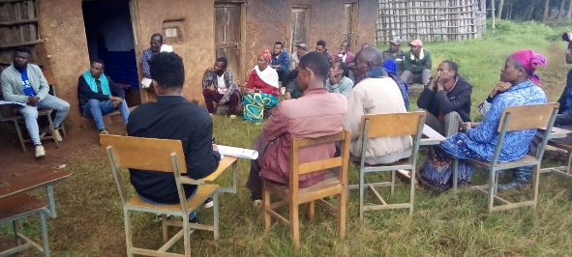
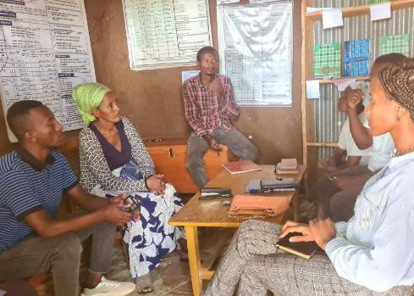
Federation’s Responsibilities and Structure
፳፫. የማህበራት ፌዴሬሽን ሥራ አስፈፃሚ ኮሚቴ አመራረጥ ፩. በጠቅላላ ጉባዔው አብላጫ ድምፅ ይመረጣሉ፡፡ … ፫. የስራ አስፈፃሚ ኮሚቴው የስራ ዘመን ከ 3 ዓመት መብለጥ የለበትም፡፡ የስራ ዘመኑን የጨረሰው የስራ አስፈፃሚው ኮሚቴን ለመተካት በሚደረግ ምርጫ ላይ የነባሩ ኮሚቴ አባል የሆነ በጠቅላላ ጉባኤው አባላት ጥንካሬው ከታመነበት ለአንድ ጊዜ በተጨማሪነት ለመጨረሻ ጊዜ ሊመረጥ ይችላል፡፡ |  | Election of Members of the Executive Committee of Federation Members of the executive committee shall be elected by the majority vote of the General Assembly; …. 3.The term of office of the executive committee shall not exceed 3 years. However, a member may be re-elected if his performance is confirmed by the General Assembly of the federation.
፳፬. የማህበራት ፌዴሬሽን ሥራ አስፈፃሚ ኮሚቴ ስልጣንና ተግባር የማህበራት ፌዴሬሽን ሥራ አስፈፃሚ ኮሚቴ የሚከተሉት ሥልጣንና ተግባራት ይኖሩታል፡- … ፫. የጠቅላላ ጉባዔውን ውሣኔ ይፈፅማል፣ያስፈጽማል፣ ፬. የማህበራት ፌዴሬሽኑን በጀት ያንቀሣቅሳል፣ ፭. የማህበራት ፌዴሬሽኑን አስፈላጊ የሆኑ ተግባራትን ያከናውናል፣ ፮. አስፈላጊ በማበረታቻ ክፍያ አገልገሎት የሚሰጡ ሠራተኞችን ያሰማራል፣ ይቀጥራል፣ |  | Powers and Responsibilities of the Executive Committee of Federation … 3.Implements decisions of the General Assembly and causes their implementation; 4. Transacts the budget of the federation; 5. Carries out the necessary activities of the federation; 6.Deploys and hires workers who provide services by offering incentives;
Federation’s Executive Committees
are managing the Federation

Slide 16
Organization and Working System of Multi-Kebele
፳፯. ብዝሀ ቀበሌ የገጠር መጠጥ ውሃና ሳኒቴሽን አገልግሎት ሰጪ ድርጅት የሚከተሉት አደረጃጀቶች ይኖሩታል ፩. የበላይ ጠባቂ ፪. ቦርድ ፫. ብዛታቸው እንደአስፈላጊነቱ የሚወሰን ተቀጣሪ ሰራተኞች ሆነዉ ዝርዝሩ በመመሪያ ይወሰናል፡፡ |  | Multi-Kebele Shall Have the Following Structure 1.Oversight body 2.Board 3.It shall have employees whose number is need-based.
 |  | Nomination of the Oversight Body The oversight body incorporates, based on conditions, Zone Administrator, or Head of the Region’s Bureau and other leaders who are assigned at various administration levels. Particulars shall be determined by a directive.
፳፰. የበላይ ጠባቂ አሰያየም የበላይ ጠባቂ እንደ አግባብነቱ የዞኑ ዋና አስተዳዳሪ ወይም የክልሉ ቢሮ ኃላፊ ሆኖ በየደረጃው ያሉ የአስተዳደር ደረጃ ላይ የተቀመጡ ሌሎች መሪዎችን ያቀፈ ይሆናል፡፡ ዝርዝሩ በመመሪያ ይወሰናል
፳፱. የበላይ ጠባቂ ተግባር እና ሃላፊነት ፩ የብዝሃ ቀበሌን በበላይነት የሚመራ፣ የሚጠብቅ እና ከቦርድ አባላት ጋር በጋራ የሚሰራ ይሆናል፡፡ … ፬. ቦርዱ እና ብዝሀ ቀበሌው ተግባሩን በተቀመጠው ደንብ መሰረት መስራቱን ይከታተላል፤ |  | Roles and Responsibilities of the Oversight Body The oversight body is an organ with a responsibility of leading and supervising the multi-kebele and works with board members. … 4. Supervises that the board and multi-kebele have carried out their activities as per the law;
Workers:
Finance & technician
Employs
Supervise
Manager
Employs
Multi – Kebele Board
Oversight body
Government Representative
Supervise
Elect
General Assembly :
All Association and WP Committee Members
Association’s Executive Committees gathered in General Assembly elect the Board which is supervised by the Oversight Body

Slide 17
Organization and Working System of Multi-Kebele
፴. የብዝሃ ቀበሌ የገጠር መጠጥ ውሃና ሳኒቴሽን አገልግሎት ሰጪ ድርጅት የቦርድ አባላት አደረጃጀት ፫. የማህበራት ተወካዮች የቦርዱ አባላት የሥራ ዘመን ሦስት ዓመት ይሆናል፡፡ ሆኖም ለመጨረሻ ጊዜ ሁለተኛ ዙር ሊሰየም ይችላል፡፡ |  | Organization of Board Members of the Multi-Kebele 3.The term of office the board members who represent associations shall be three years. A board member may be re-elected for the second term for a final time.
 |  | Responsibilities and Duties of the Board of the Multi-Kebele 1.Oversees and controls the multi-kebele; 2.Establishes the procurement, finance and property management system of the multi-kebele; follows up the implementation thereof; 5.Recruits, evaluates, and dismisses employees of the multi-kebele. Particulars shall be determined by a directive;
፴፩. የብዝሃ ቀበሌ ቦርድ ኃላፊነትና ተግባር ፩. የብዝሀ ቀበሌውን በበላይነት ይመራል፤ ይቆጣጠራል፤ ፪. የብዝሀ ቀበሌውን የግዢ፤ የፋይናንስ እና ንብረት ቁጥጥር ስርዓት ይዘረጋል፤ አፈፃፀሙንም ይከታተላል፡፡ ፭. የብዝሃ ቀበሌ ሰራተኞችን መቅጠር፣ መገምገም እና ማሰናበት፡፡ ዝርዝሩ በመመሪያ ይገለጸል፡፡
፴፪. የስራ አመራር ቦርድ የስብሰባ ስነስርዓት ፩. ቦርዱ እንደአስፈላጊነቱ የሚያደርገው አስቸዄይ ስብሰባ እንደተጠበቀ ሆኖ፣ በየሩብ ዓመቱ መደበኛ ስብሰባውን ያደርጋል፡፡ ፪. ከቦርዱ አባላት መካከል ሁለት ሶስተኛው ከተገኙ ምልዓተ ጉባኤ እንደተሟላ ይቆጠራል፡፡ |  | Procedures of Board Meetings 1. The Board shall hold its regular meetings on a quarterly basis… 2. There shall be a quorum when two-thirds majority of Board members are present.
Workers:
Finance & technician
Employs
Supervise
Manager
Employs
Multi – Kebele Board
Oversight body
Government Representative
Supervise
Elect
General Assembly :
All Association and WP Committee Members
Multi-Kebele ’s Board takes
Strategic Decision

Slide 18
Organization and Working System of Multi-Kebele
፴፫. የብዝሃ ቀበሌ ድርጅት ሥራ አስኪያጅ ኃላፊነትና ተግባር … ፪. የቦርዱን ውሳኔ ተግባራዊ ያደርጋል፣ ፫. የብዝሃ ቀበሌ አደረጃጀትን ፋይናንስና በጀት ያስተዳድራል፣ ፬. የብዝሃ ቀበሌው ሁሉም ተግባራት እየተከናወኑ መሆናቸውን ያረጋግጣል፣ |  | Responsibilities and Duties of Manager of the Multi-Kebele … 2. Implements the decisions of the Board; 3. Administers finance and budget of the multi-kebele structure; 4. Manages assets of the multi-kebele;
፴፬. የብዝሀ-ቀበሌ ድጋፍ፣ክትትልና ግምገማ ሥርዓት የብዝሀ-ቀበሌ ድጋፍ፣ክትትልና ግምገማ ሥርዓት የቢሮው እና የበላይ ጠባቂ ኃላፊነት ነው፡፡ |  | Support, Monitor, and Evaluation of Multi-Kebele Support, supervision, and evaluation of the multi-kebele is responsibility of the Bureau and the oversight body.
Workers:
Finance & technician
Employs
Supervise
Manager
Employs
Multi – Kebele Board
Oversight body
Government Representative
Supervise
Elect
General Assembly :
All Association and WP Committee Members
The Multi-Kebele's activities are carried out by its manager and its workers

Slide 19
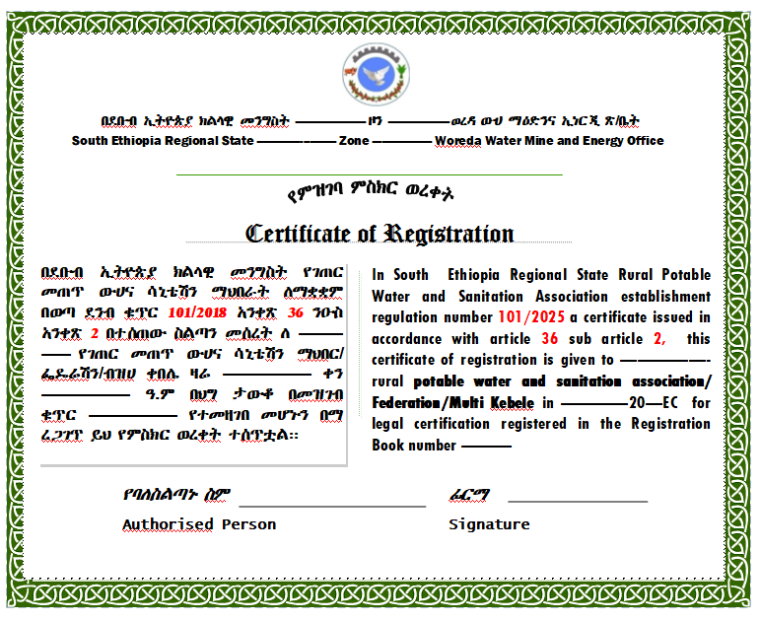
Registration and Bylaw of Water Service Organization
፴፯. ገጠር የመጠጥ ውሃ እና ሳኒቴሽን አገልግሎት ድርጅት ምዝገባ፡- ፩. ማንኛውም በዚህ ደንብ መሠረት የሚቋቋም የውሃ አገልግሎት ድርጅት በቢሮው መመዝገብ ይኖርበታል፡፡ ፪. ምዝገባው የሚካሄደው ለመጠጥ ውሃ አገልግሎት ሰጪ እና በስሩ ላለው ማህበር በጋራ ነው። |  | Registration of Water Service Organization 1. Any water service organization established according to this Regulation shall be registered by the Bureau. 2. The registration shall be done jointly for the water service organization and the association under it.
 |  | Bylaw of Water Service Organization 1. Each water service organization shall have its own bylaw.
፴፱. ስለ ገጠር መጠጥ ውሃ ሳኒቴሽን አገልግሎት ድርጅት መተዳደሪያ ደንብ ፩. እያንዳንዱ የገጠር መጠጥ ውሃ ሳኒቴሽን አገልግሎት ድርጅት የራሱ መተዳደሪያ ደንብ ይኖረዋል፣
፵. የማህበራት ፌዴሬሽን እና ብዝሀ ቀበሌ አገልግሎት ሰጪ ድርጅት መፍረስ ፩. አገልግሎት ሰጪ ድርጅት የሚፈርሰው አገልግሎት ተቀባይ ማህበር ከሌለው ከሌላ አገልግሎት ሰጪ ጋር በመዋሀዱ ይሆናል። |  | Dissolution of Federation and Multi-kebele Service Provider Organization 1. If a service provider organization does not have a service recipient association or when it merges with another service provider, it shall dissolve

Slide 20
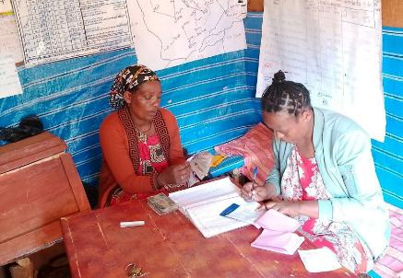


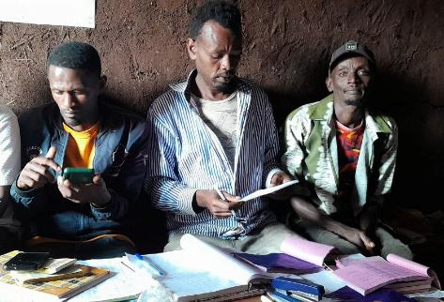
Finance Sources, Revenue Utilization, Audit, and Inspection
፵፩. ስለገጠር መጠጥ ውሃ አገልግሎት ድርጅቶች የገንዘብ ምንጭ ፩. ከአባላት መመዝገቢያና ልዩ ልዩ መዋጮ ፪. ከውሀ አገልግሎት ክፊያ ፣ቧንቧ ከማስቀጠልና ከሌሎች የተያያዙ ሥራዎች የሚገኝ ገቢ፣ ፫. ከስጦታ፤ ከእርዳታ እና ከቅጣቶች |  | Sources of Revenue of the Water Service Organizations 1. Membership registration fees and miscellaneous contributions; 2. Water service fees, revenues from pipe extension and other related activities; 3. Donations, aids, and fines.
 |  | Determination of Potable Water Tariff and Utility Fee 1. Zone shall have the responsibility to set potable water tariff for the administrative levels; where there is disparity between tariffs of two zones, the tariff shall be determined by the Bureau. 2.When determining tariff, the following shall be taken into consideration: a) The paying capacity of the community of the area; b) Covering the costs of administration and other necessary activities of the water scheme; … d) Type of the water scheme and its service quality;
፵፪. የመጠጥ ውሃ ታሪፍ አወሳሰንና ክፍያ ፩. በየአስተዳደር እርከኑ የሚገኙ የመጠጥ የውሃ ታሪፍን የመወሰን ኃላፊነት የዞኑ ሆኖ በሁለት ዞኖች መካከል ልዩነት ሲኖር በቢሮዉ ታሪፍን ይወስናል ፡፡ ፪. ታሪፉ በሚወሰንበት ጊዜ የሚከተሉትን ከግንዛቤ ማስገባት ይኖርበታል፡- ሀ) የአካባቢውን ማህበረሰብ የመክፈል አቅም ያገናዘበ፣ ለ) የውሃ ተቋሙን አስተዳደራዊ ወጪ ለመሸፈን የሚያስችል እና ለሌሎች አስፈላጊ ስራዎች መቆጠብ የሚያስችል … መ) የተቋሙን አይነትና አገልግሎት አሰጣጥ ያገናዘበ መሆን አለበት፣
The Zone set the minimum Tariff

Slide 21
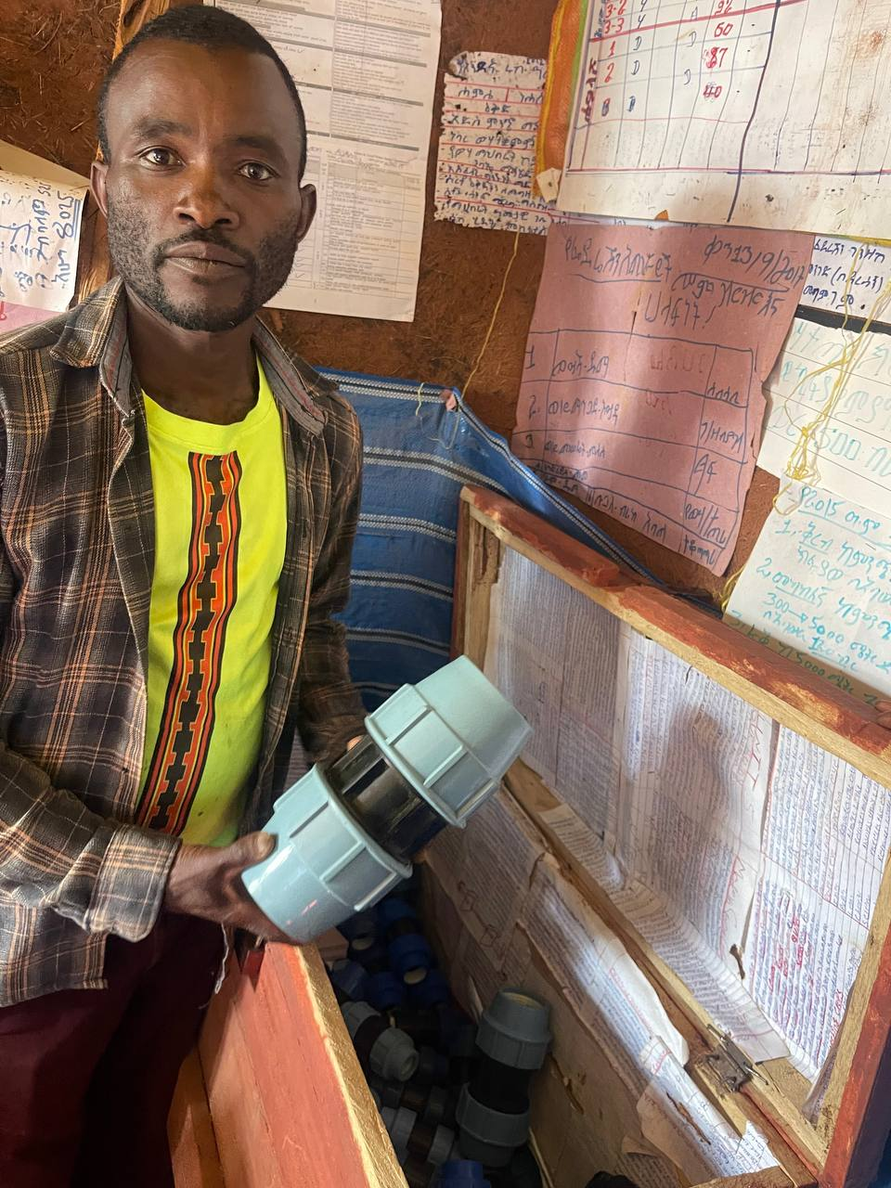
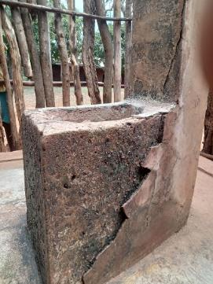

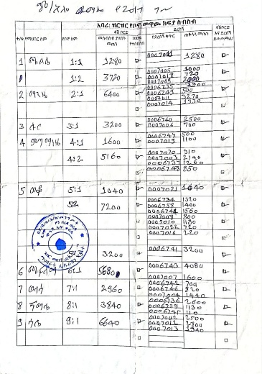
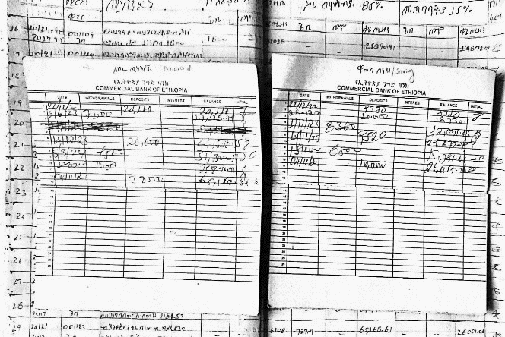
Finance Sources, Revenue Utilization, Audit, and Inspection
፵፫. ስለ ገቢ አጠቃቀም ፩. የውሀ ተቋማቱን የኦኘሬሽንና ጥገና ወጭዎችን፣የመልሶ ግንባታ ወይም የማስፋፋያ ሥራዎችን ለማከናወን፣ ፪. አገልግሎት ሰጪ ድርጅቱ በማበረታቻ ለሚያሰማራቸው ወይም ለሚቀጥራቸው ሠራተኞችና ባለሙያዎች ደመወዝ፣ … ፭. ለመልሶ ግንባታ እና ለማስፋፊያ ስራዎች ገንዘብ ለመቆጠብ ፮. ለውሃ አገልግሎት የተሰበሰበው ገንዘብ ከላይ ከተገለጹት ዓላማዎች ውጪ ለሌሎች ጉዳዮች ማዋል አይቻልም |  | Use of Revenue 1.To cover the costs of operation, maintenance rehabilitation or expansion works; 2.To cover the costs of those who the organization deploys on the basis of incentive provision or payment of salaries for its employees and technicians; … 5.To save money for future rehabilitation or expansion works; 6.The money collected for water services cannot be used for purposes other than the ones mentioned above.
 |  | Audit and Inspection 1. The audit of a rural water provider organization includes the audit of associations under it. 2. The audit is carried out by personnel delegated by the Bureau
፵፭. ኦዲትና ኢንስፔክሽን ፩. የገጠር ውሃ አገልግሎት ሰጪ ድርጅት ኦዲት በስሩ ያሉትንም ማህበራት ኦዲት ያካትታል፡፡ ፪. ኦዲቱ የሚከናወነው በቢሮው ውክልና በተሰጣቸው ሠራተኞች ተቋማት ነው። ዝርዝሩ በመመሪያ ይወሰናል
before
after
Water Revenue are for Water Service only
Water Service Organisation are Audited by the WWO

